Slide 1


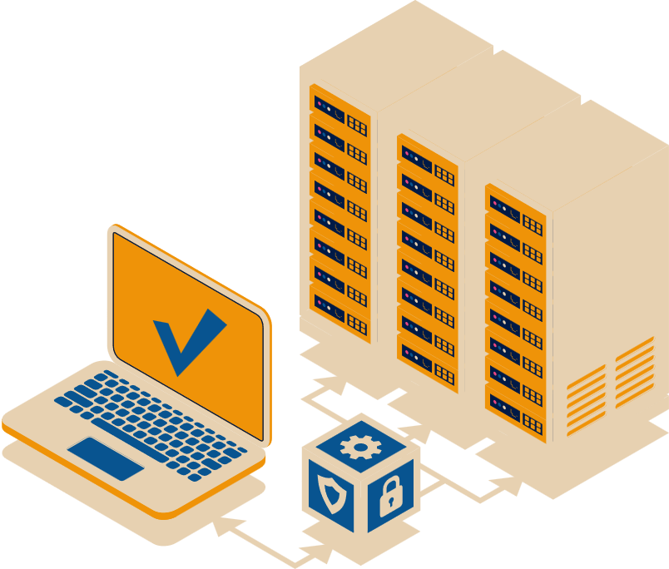

Cloud Based IT Solution

Slide 2





ABOUT
SaaS Application
Comply with DORA and Outsourcing Regulations
Data in Europe
Hosted on Microsoft Azure

Slide 3








Regulation Challenges
Issues for Financial Entities and Insurances in complying with DORA and Outsourcing regulations
Complex Regulatory Environment
Cybersecurity
Global Risk Management
Skills
Data Protection & Privacy
Third Party Risk Management
Budget Contraints
Expertise Shortage

Slide 4
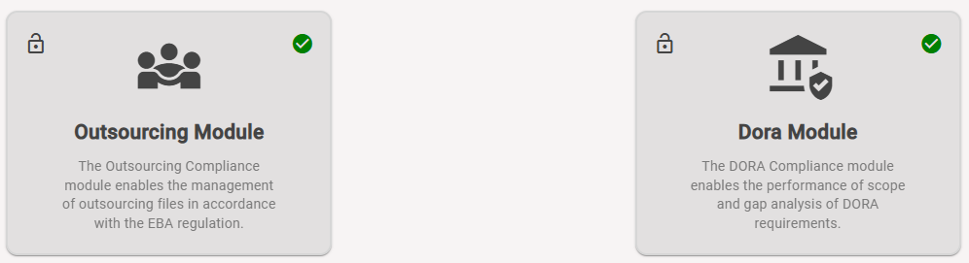

OUR MISSION
Standardization of regulated Compliance
Intuitive User Interface
Centralized Compliance Management
Continuous Monitoring and Automated Alerts
Automatic reporting
Adaptability to Regulatory Changes

Slide 5
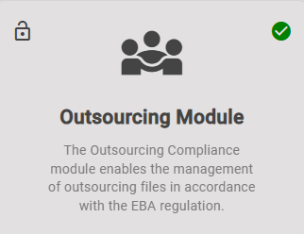
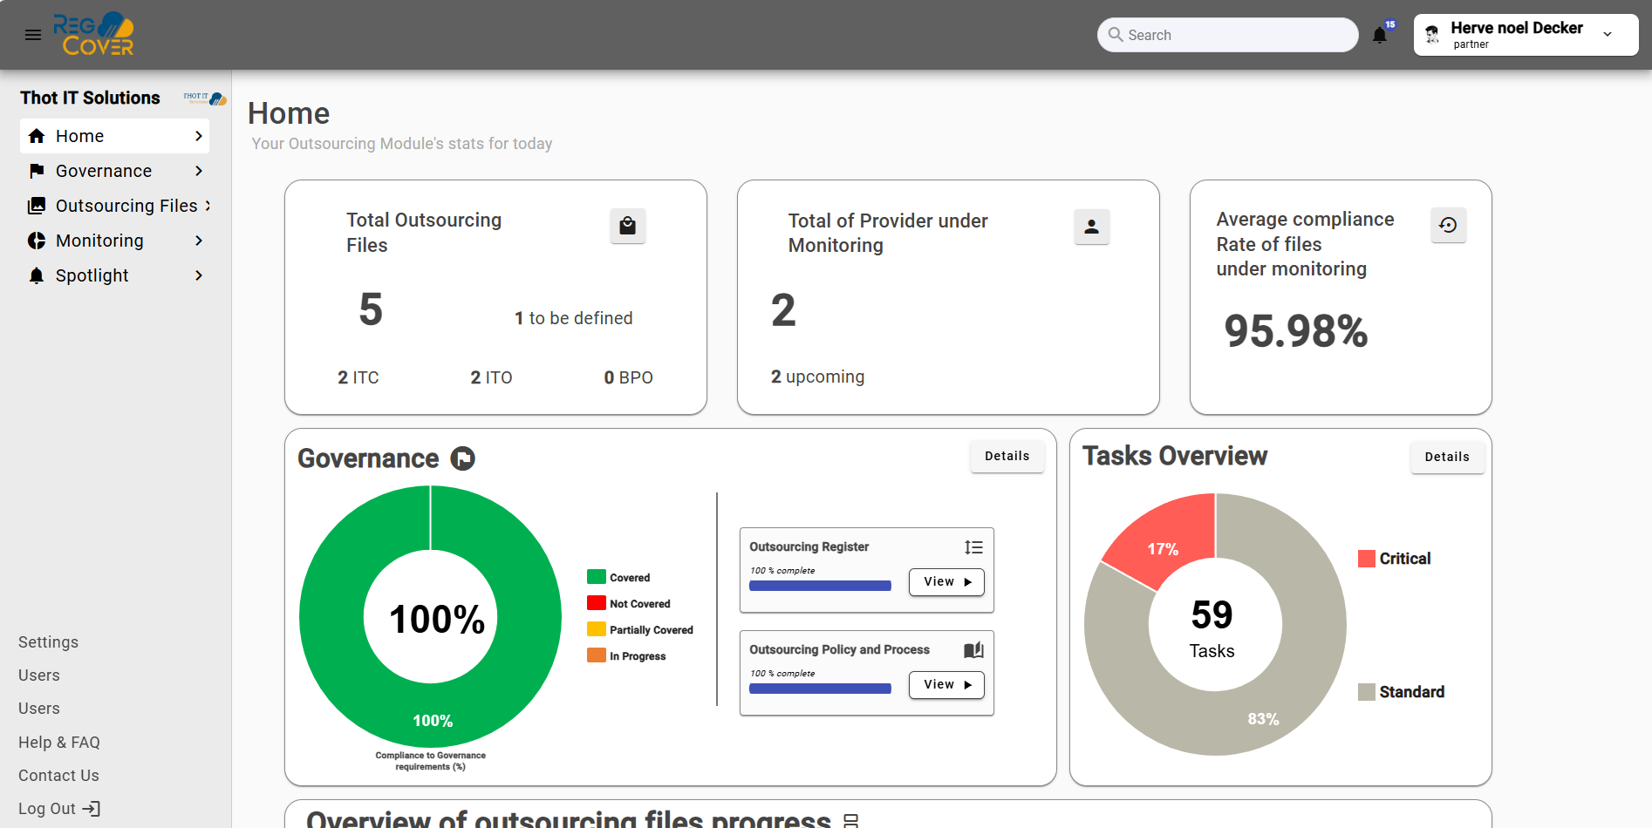
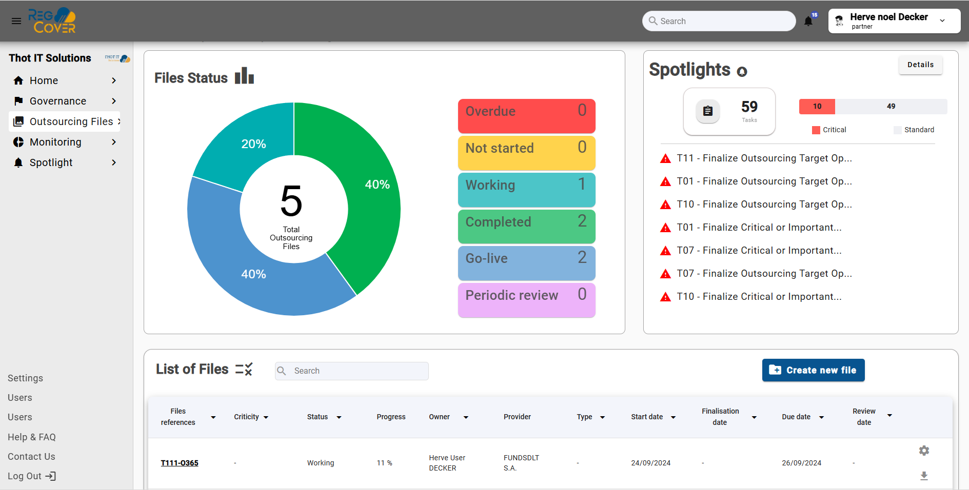
OUR GOAL
To automate your Outsourcing Processes
Automatic Outsourcing File
Automatic update of outsourcing regulated requirements
Automatic generation of the notification for the supervision authority
Automatic outsourcing registry update
Continuous Monitoring and oversight

Slide 6
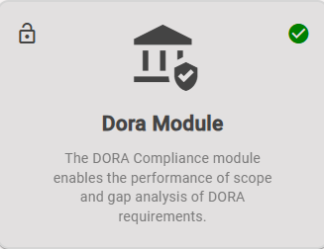
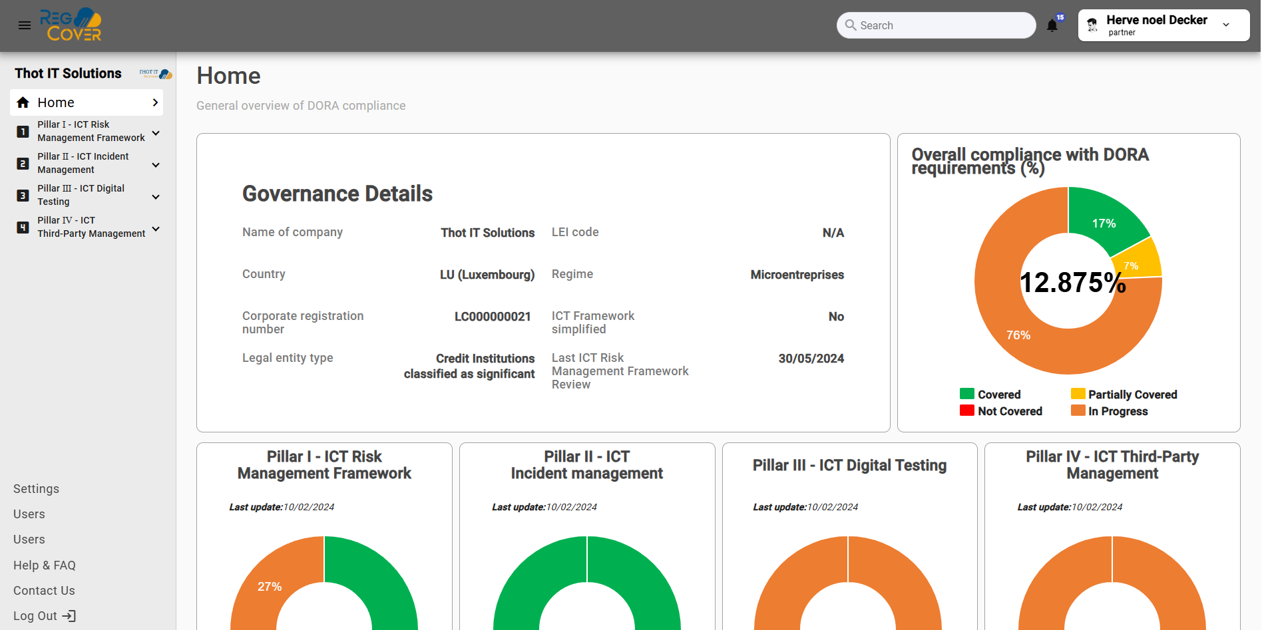
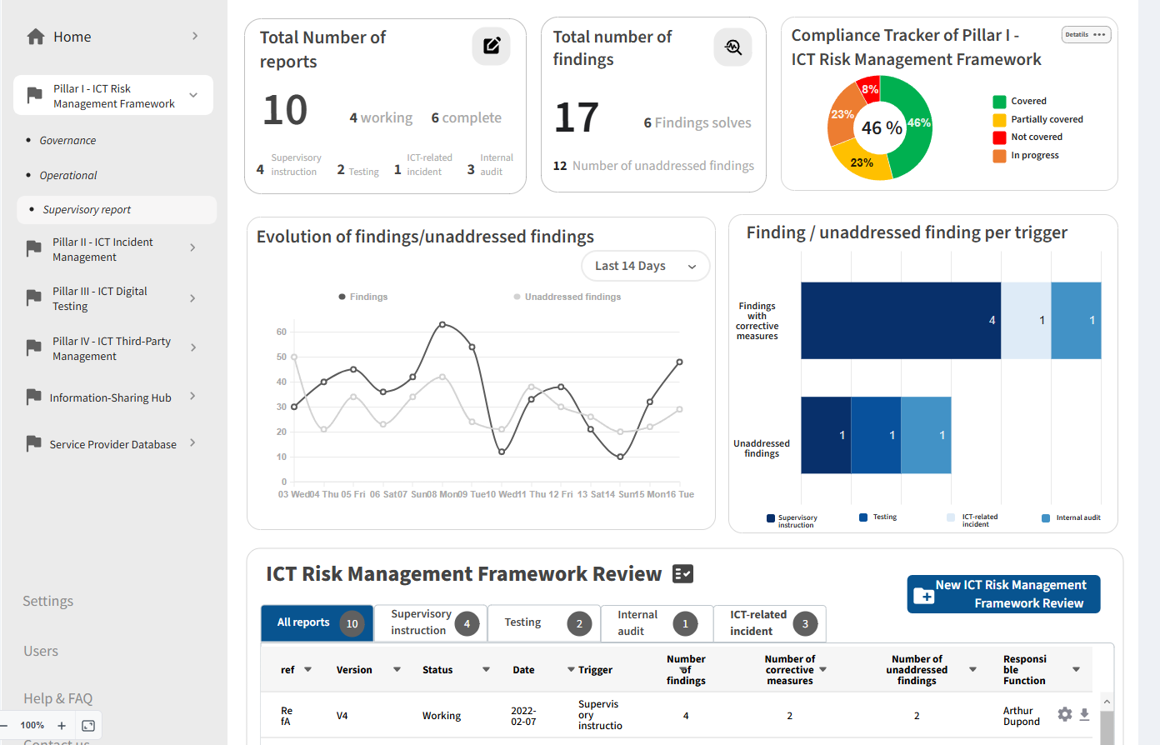
OUR GOAL
To automate your DORA Processes
Automatic DORA File
Automatic update of DORA regulated requirements
Automatic generation of Reports for the supervision authority (Risks, Incident, Testing)
Automatic DORA registry update
Continuous monitoring and oversight

Slide 7
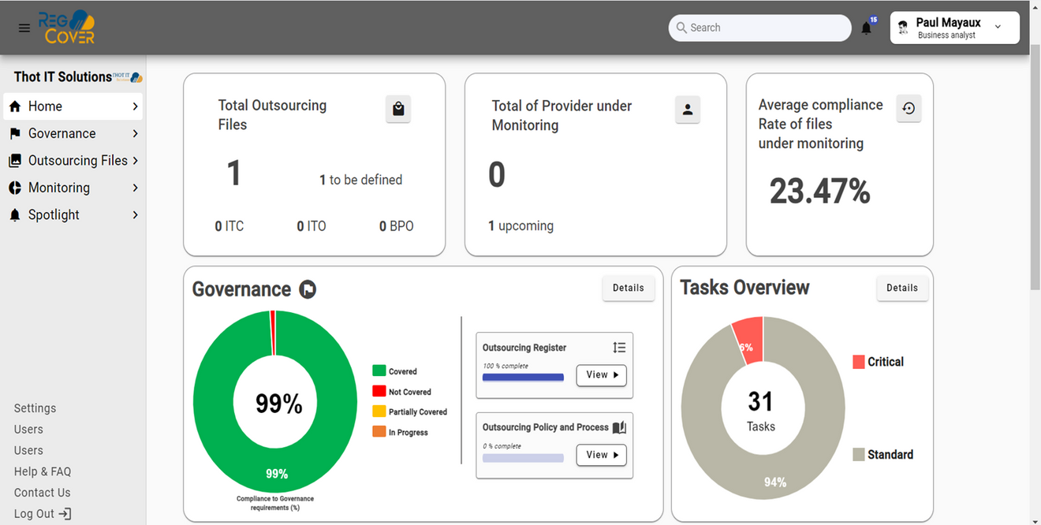
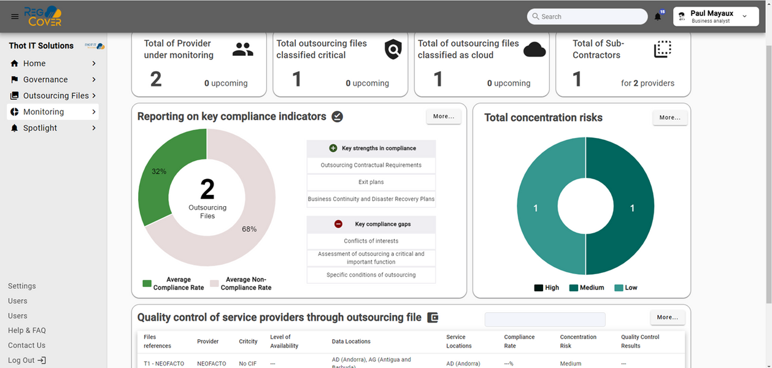
YOUR BENEFITS
Cost efficiency
Time saving in managing compliance processes (Governance & Operational).
30% to 40% productivity savings per filing
Reduction of non-compliance risks through standardization.
Continuous Monitoring and Alerts
Comprehensive Adherence Reporting
Enhanced Collaboration
Scalable solution
Automatic Updates and Maintenance

Slide 8







Information or
Demonstration ?
Edgard.leclipteur@thot-it.com
or +352 661 880 549

