Slide 1
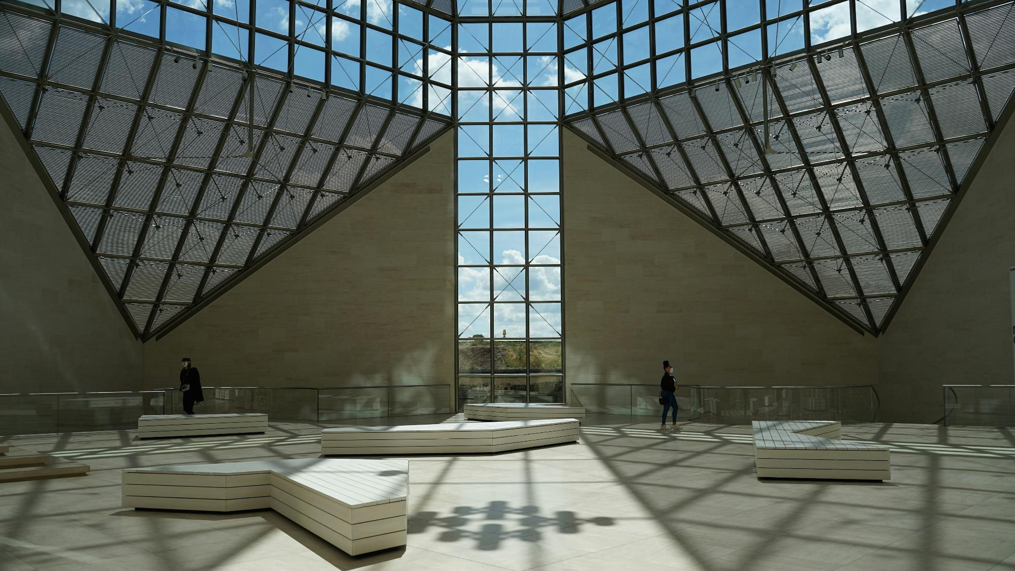

Luxembourg Valuation Committee
Valuation Diary – Qx 202x
www.lpea.lu | lpea-office@lpea.lu
©LPEA, 2026

Slide 2

Valuation Analysis – Qx 202x
This document structure the analysis on each asset
Voting committee members | e.g. CO Valuation
Non-voting committee members | e.g. CO Risk, PE analyst, etc.
Attendees | e.g. expert on a specific project or interest party
Date of meeting
Date of approval

Slide 4
Assets Overview
The table below shows which assets the LUX-ValCo will focus on but all assets should be listed.
Asset | Trigger 1 | Trigger 2 | Trigger 3 | In Scope for detailed analysis
 | Valuation tolerance threshold (≥xx%) | ABS materiality threshold (EUR xxM) | Luxembourg funds allocation (≥xx%)
Asset 1 | 26,32% | 2 000 000 | 5.40% | Y
Asset 2 | 14% | 1,877,550.00 | 0.11% | Y

Slide 5
Asset 1 (1)
This page is the main point of dicussion for Asset 1. It details the analysis and the question(s) raised by the LUX Valuation Committee
Project overview | Explain how the asset was acquired Present the asset briefly Provide key milestones in the asset life Provide latest updates on the asset In case of PE/VC: Calibration at acquisition date
Security type | Loan Pools | Line of business |  |  | Industrial Loan | Country | US
Valuation | Qn-1 MV | In/Out Flows |  |  | Qn MV | Variance
 | 10 000 000 $ | - 500 000 $ (distr) |  |  | 12 000 000 $ | 26,32%
Analysis | Valuation Model Consistency | Unchanged: DCF | Unchanged: DCF. If market-based: Peer group is stable. Provide info on backtesting if applicable |  |  |  |  | OK
 | Valuation Model Accuracy | The DCF methodology and assumptions has been reviewed on XX/XX/XX | The DCF methodology and assumptions has been reviewed on XX/XX/XX |  |  |  |  | OK
 | Trigger 1 : Valuation tolerance threshold (≥xx%) |  | The variance 23,32% is considered material as it is above the defined threshold of xx% |  |  |  |  | Material
 | Trigger 2: ABS materiality threshold (EUR xxM) |  | The absolute change is not considered material as below threshold |  |  |  |  | Not material
 | Trigger 3: Luxembourg funds allocation (≥xx%) |  | The asset only represents 5% of the total Fund, which is slightly above the threshold |  |  |  |  | Material
LUX Valuation Committee question | What triggers the increase in valuation ? What justifies the change in the discount rate ? |  | Conclusion | The discount rate has been changed because of …

Slide 6
Asset 1 (2)
This page provides all additional information that can be used to provide context to the Asset 1 (milestones, backtesting, operational cash flows, etc)
Valuation Key Indicators | EBITDA Sales Liquidity etc

Slide 7
Annexes
Annex 1
Annex 2

Slide 8
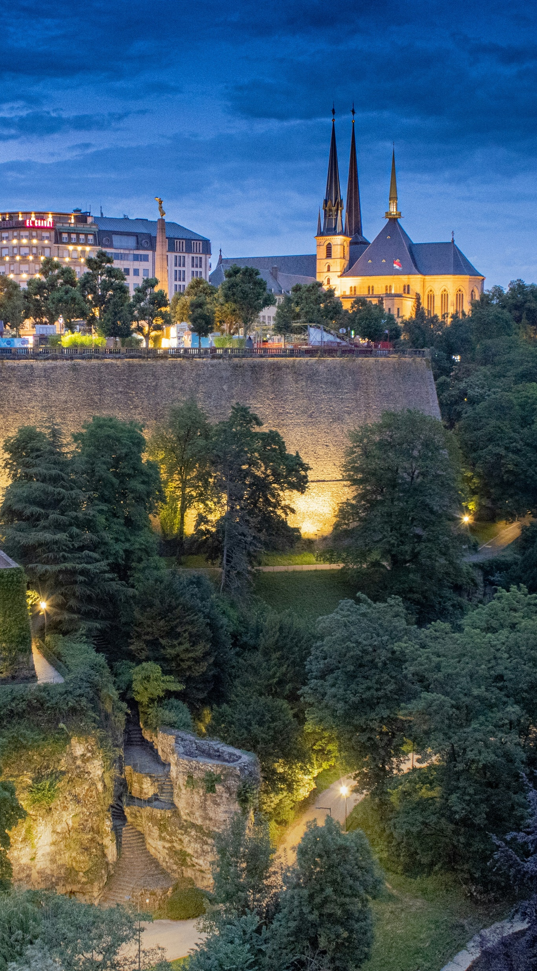
About LPEA
The Luxembourg Private Equity and Venture Capital Association (“LPEA”) aims at promoting and defending the interests of investors and professionals principally active in the field of Private Equity (“PE”) and Venture Capital (“VC”).
The Association is the trusted and relevant representative body of PE and VC practitioners with a presence in Luxembourg.
Created in 2010 by a leading group of PE and VC players, with more than 700 members, LPEA plays a leading role locally, actively promoting PE and VC in Luxembourg.
LPEA provides a dynamic and interactive platform, which helps investors and advisors to navigate through latest trends in the industry. International by nature, the Association allows members to network, exchange experience, expand their knowledge and grow professionally by attending workshops and trainings held on a regular basis.

Slide 9

About the document
The work presented herein was prepared by representatives of the Luxembourg Private Equity and Venture Capital Association AIFM Operations cluster (the “LPEA AIFM Operations cluster”).
This document is a suggested set of operational tools intended to assist industry participants in their valuation framework by outlining what may be considered a reasonable approach. It is provided for general informational purposes only and is not intended to constitute legal, regulatory, compliance, or other professional advice, nor does it represent official guidance.
The content of this document is not intended to be applied uniformly in all circumstances. Firms should assess its relevance and applicability in light of their specific facts, business model, risk profile, and applicable legal and regulatory
The Association does not provide specific advice and does not endorse or recommend any particular company, product, or service over another.
While reasonable care has been taken in preparing this document, no representation or warranty is made as to its completeness or accuracy. It should not be relied upon as a substitute for independent professional judgment or advice tailored to the particular circumstances of any entity.
Neither the LPEA nor any of their working groups, committees, members or any other person having contributed in any way whatsoever to this document accepts any responsibility or liability for damages arising out of the use of this document.

Slide 10




Luxembourg Private Equity &
Venture Capital Association
www.lpea.lu
+ 352 28 68 19
lpea-office@lpea.lu
14, rue Erasme, L-1468 LUXEMBOURG

