Slide 1
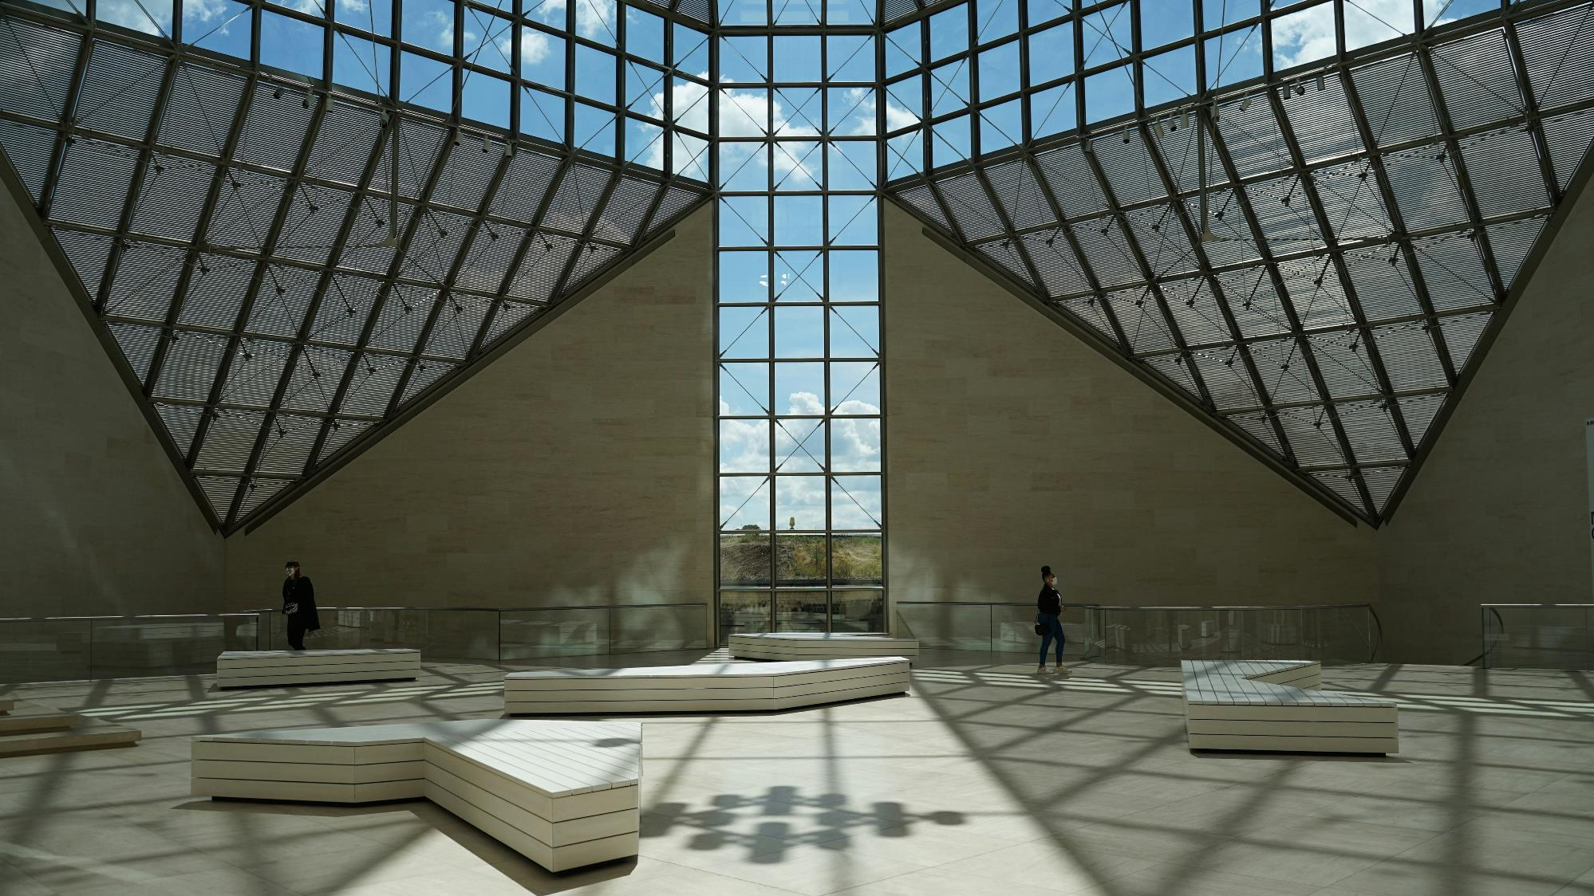

Luxembourg Valuation Committee
Valuation Diary – Qx 202x
www.lpea.lu | lpea-office@lpea.lu
©LPEA, 2026

Slide 2
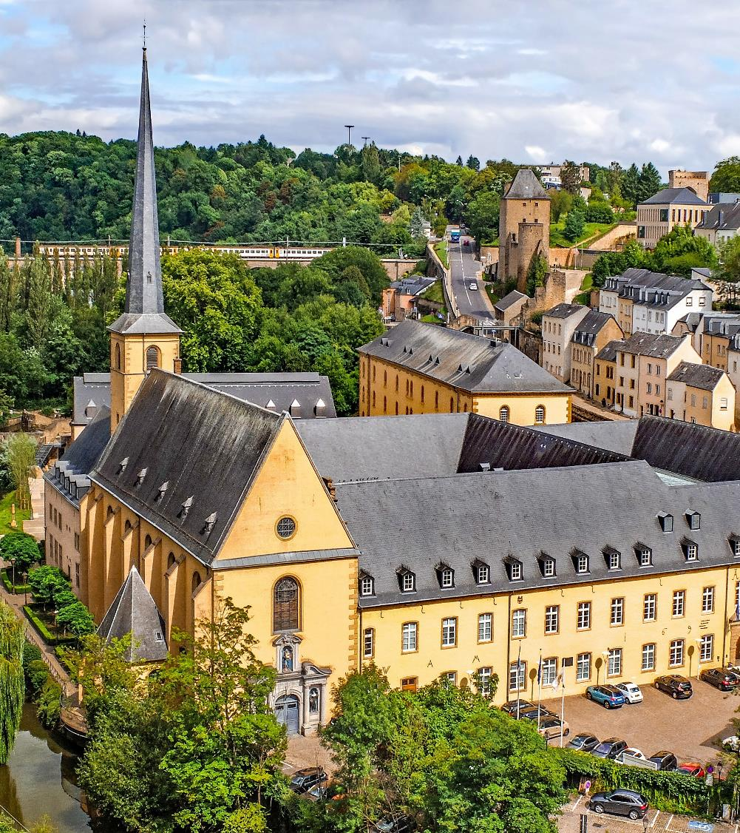
Valuation Diary – Qx 202x
This diary can help evidence proper oversight and can be a useful addition nto Board packs. While detailed analysis on assets could be provided in the annexes, the diary itself would offer a clear high-level summary of the valuation efforts undertaken by the LUX AIFM.
Voting committee members | e.g. CO Valuation
Non-voting committee members | e.g. CO Risk, PE analyst, etc.
Attendees | e.g. expert on a specific project or interest party
Date of meeting
Date of approval

Slide 3
Valuation
Process Overview
This first slide should present how the valuation process works according to the valuation policy. Below is only an example
Group Valuation Committee
LUX Valuation Committee
LUX Administrator
  Valuation marks are suggested by the Group (outside of Luxembourg)
  Approval from this non-LUX committee is not sufficient for the LUX AIFM
  The Lux AIFM holds its Valuation Committee and approved the marks of the Lux Funds
  Marks are then sent to the Administrator
  Computes the NAV based on the validated marks of the AIFM
  NAV will then be later approved by the AIFM

Slide 4
These slides should record all key valuation-related events happened during the quarter in a chronological order. Below events are only examples but must be tailored according to the valuation policy. As such, it might include calls with external valuers, etc.
Valuation Process Highlights – Qx 202x
Date | Type of event | Minutes and outcome
25/06/ 2025 | Non-LUX Valuation Committee | PE strategy: US Assets: Globally, projects perform well in line with expectations. XX provided an update on the overall market performance following the FED rate cuts, etc. Asset 1 : prudent approach although a peer has been sold for a higher multiple. No mark-up for now. Asset 2 : Investment extension continuing Asset 3: xxx Asian Assets Asset 1: xxx Asset 2: xxx | Pipeline Update Project 1: AML DD being performed Project 2: Closing. Signed agreements to be received. Hospitality Projects Embassy Suite, Central Park & Colony Hotel: downward trend in the market is noted (not in the CCL portfolio).
04/07/ 2025 | Investee Call | Minutes of the investee call (assets discussed, market update, etc.)
11/07/ 2025 | LUX Valuation Committee | The Luxembourg Valuation Committee was held on 11th July 2025. Members were Member 1 (Voting), Member 2 (non-voting), member 3 (non-voting). Participant 1 and Participant 2 were invited as guests to the discussion. The meeting was opened, and the committee went through the valuation deck. All assets were reviewed but the focus has been on a few selected ones according to the criteria defined in the valuation policy (relative variance, absolute variance, relative size of the position in the Luxembourg Funds). | The Committee discussed the below assets: Asset 1: asset is performing well, the drop in valuation comes from a distribution Asset 2: asset has been severely impacted by the retail market Asset 3: xxx The Luxembourg Valuation Committee agreed that all marks were justified based on the information received and that the approved valuation marks have been provided to the Administrator on 12/07/25.

Slide 5
Annexes
Annex 1
Annex 2

Slide 6
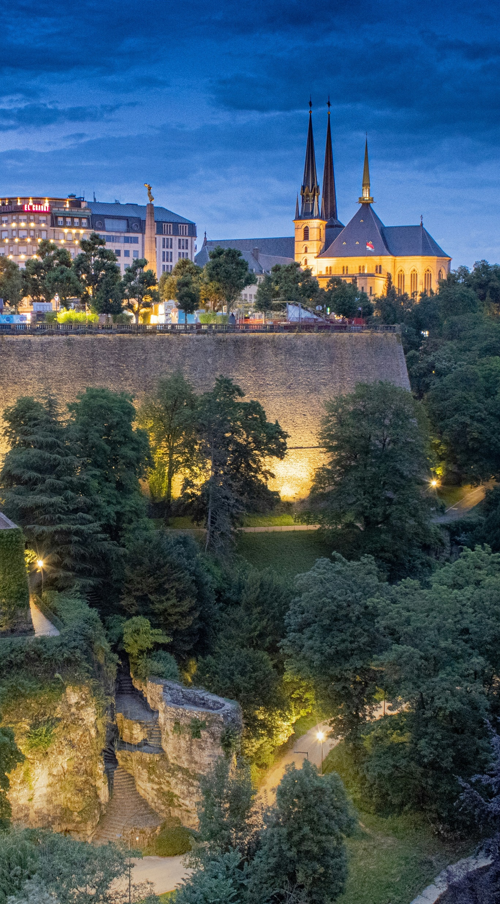
About LPEA
The Luxembourg Private Equity and Venture Capital Association (“LPEA”) aims at promoting and defending the interests of investors and professionals principally active in the field of Private Equity (“PE”) and Venture Capital (“VC”).
The Association is the trusted and relevant representative body of PE and VC practitioners with a presence in Luxembourg.
Created in 2010 by a leading group of PE and VC players, with more than 700 members, LPEA plays a leading role locally, actively promoting PE and VC in Luxembourg.
LPEA provides a dynamic and interactive platform, which helps investors and advisors to navigate through latest trends in the industry. International by nature, the Association allows members to network, exchange experience, expand their knowledge and grow professionally by attending workshops and trainings held on a regular basis.

Slide 7
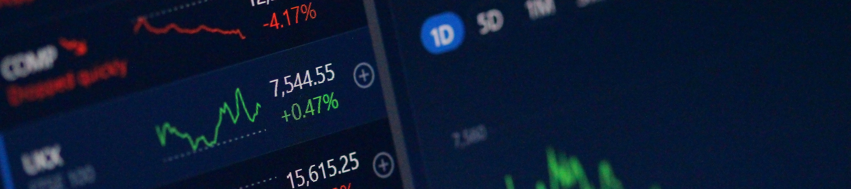
About the document
The work presented herein was prepared by representatives of the Luxembourg Private Equity and Venture Capital Association AIFM Operations cluster (the “LPEA AIFM Operations cluster”).
This document is a suggested set of operational tools intended to assist industry participants in their valuation framework by outlining what may be considered a reasonable approach. It is provided for general informational purposes only and is not intended to constitute legal, regulatory, compliance, or other professional advice, nor does it represent official guidance.
The content of this document is not intended to be applied uniformly in all circumstances. Firms should assess its relevance and applicability in light of their specific facts, business model, risk profile, and applicable legal and regulatory requirements, and adapt it as they deem appropriate.
The Association does not provide specific advice and does not endorse or recommend any particular company, product, or service over another.
While reasonable care has been taken in preparing this document, no representation or warranty is made as to its completeness or accuracy. It should not be relied upon as a substitute for independent professional judgment or advice tailored to the particular circumstances of any entity.
Neither the LPEA nor any of their working groups, committees, members or any other person having contributed in any way whatsoever to this document accepts any responsibility or liability for damages arising out of the use of this document.

Slide 8




Luxembourg Private Equity &
Venture Capital Association
www.lpea.lu
+ 352 28 68 19
lpea-office@lpea.lu
14, rue Erasme, L-1468 LUXEMBOURG

